Slide 1
BANK LOAN ANALYSIS
A COMPREHENSIVE EXAMINATION OF LOAN DATA using excel
BY
AKASH NARANG

Slide 2
Background
The banking sector plays a critical role in the economy by providing loans to individuals and businesses. Understanding the trends in bank loans—such as the volume, types, and repayment patterns—can help financial institutions optimize their lending strategies, improve customer service, and manage risk more effectively.
Despite the availability of comprehensive loan data, the bank lacks a clear understanding of the overarching trends affecting its loan portfolio. Without insights into how factors such as interest rates, borrower demographics, and economic conditions influence loan origination and performance, the bank may miss opportunities for growth and risk management.

Slide 3
Objectives
Identify and analyze trends in loan volume, types, and borrower profiles over time.
Examine the relationship between macroeconomic factors (e.g., interest rates, employment length etc.) and loan performance.
Evaluate shifts in repayment behaviors and default rates across different loan categories.
Provide strategic recommendations based on identified trends to inform future lending practices and policies.

Slide 4
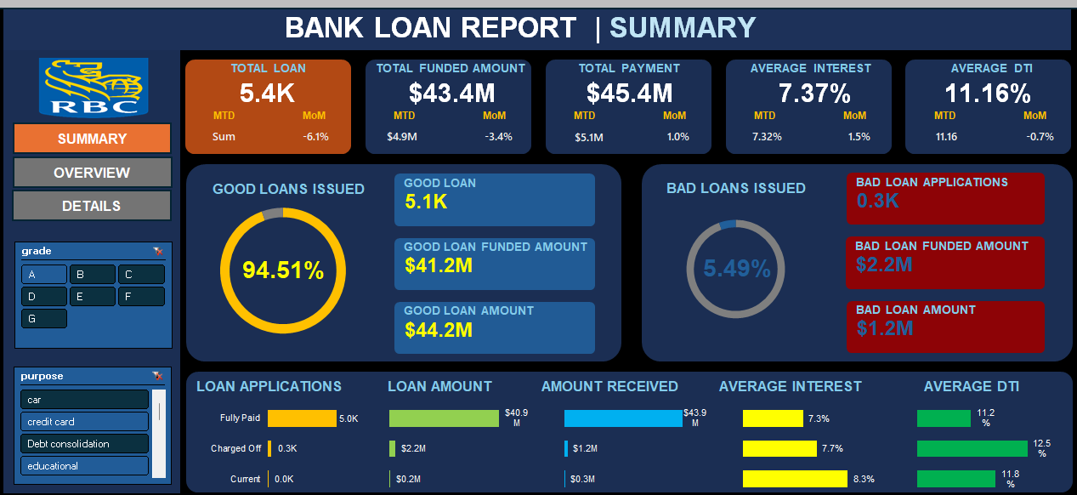
EXCEL DASHBOARD

Slide 5
INSIGHTS
Total loan portfolio stands at $435.8M.
Average interest rate across all categories of loans in 12.05%.
Average Debt to Income ratio across all categories of customers is 13.67%.
Standard loans form 86.18% of total loan portfolio and distressed loans form 13.82% of total loan portfolio.
73% of the loans have been sanctioned for a tenure of 36 months and 27% of the loans have been sanctioned for a tenure of 60 months.
23% of loans have been sanctioned to employees which have been working in a particular organization for 10 years or more.

Slide 6
Recommendations
Distressed loans form 13.82% of loan portfolio. This is much higher side compared to industry standard. Immediate focus is required to reduce this number.
Efforts can be made to sanction loans with a higher tenure. This will ensure long term interest income for the bank and will also increase cross selling opportunities since customers will be associated for a longer term with the bank.
Average debt to income ratio is on lower side. This indicates that existing loan customers are not contacted for more upselling possibilities. Efforts should be made to convince existing customers for availing higher amount of loans.
Possibilities of tie-ups with various organizations can also be explored by launching loan products tailored to the needs of their employees.

